Slide 1
Chapter 2 The Relational Model of Data

Slide 2
Objectives
Understand what is the relational model and database design basing relational model.
Conceptualize data using the relational model.
Understand what basic relational algebra operators under set semantics.
Express queries using relational algebra.

Slide 3
Contents
2.1 An Overview of Data Models
2.2 Basics of the Relational Model
2.3 An Algebraic Query Language

Slide 4
2.1 An Overview of Data Models
Data model: a collection of concepts for describing data, including 3 parts:
    Structure of the data
      Ex: arrays or objects
    Operations on the data
      Queries and modification on data
    Constraints on the data
      Limitations on the data

Slide 5
2.1 An Overview of Data Models
  The relational model, including object-relational extensions
  The semi-structured data model, including XML and related standards
  Semi-structured data resembles trees or graphs rather than tables or arrays
  XML, a way to represent data by hierarchically nested tagged elements
  Operations involve following paths in tree from an element to one or more of its nested sub elements, and so on
  Constraints involve the data type of values associated with a nested tag

Slide 6
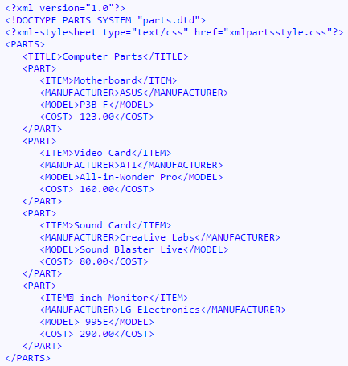
2.1 An Overview of Data Models

Slide 7
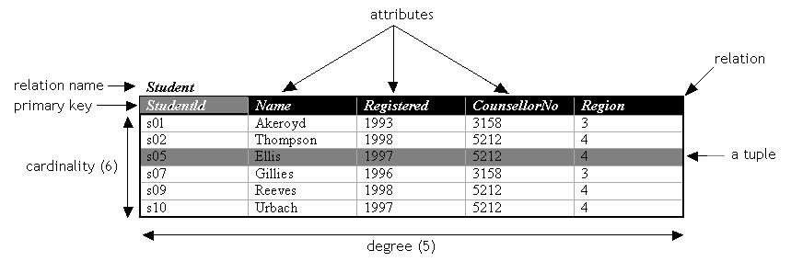
2.2 Basics of the Relational Model
Relational model
  A relation is made up from 2 parts:
    Schema: specifies name of relation, name of attributes and domain/type of one’s.
      Ex: Student(StudentID: string, Name: string, Registered: int, CounsellorNo: int, Region: int)
    Instance: a table with rows and columns
      Rows ~ cardinality; columns ~ degree/arity
  A simple thinking: a relation as a set of distinct rows or tuples

Slide 8
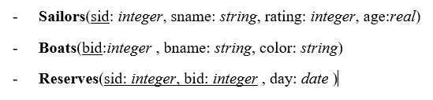
2.2 Basics of the Relational Model
Database schema: a set of schemas for the relations of a database
An example of DB schema:

Slide 9
2.2 Basics of the Relational Model
Key attribute
Non-key attribute
Multi-valued attribute
Derived- attribute
Candidate key
Primary key
Foreign key

Slide 10
2.3 An Algebraic Query Language
Relational Algebra
  An algebra consists of operators and atomic operands
  Relational algebra is an example of an algebra, its atomic operands are
    Variables that stand for relations
    Constants, which are finite relations
  Relational algebra is a set of operations on relations
  Operations operate on one or more relations to create new relation

Slide 11
2.3 An Algebraic Query Language
Relational algebra fall into four classes
  Set operations – union, intersection, difference
  Selection and projection
  Cartesian product and joins
  Rename

Slide 12
2.3 An Algebraic Query Language
Set operations
Union
  R ∪ S = { t | t ∈ R ∨ t ∈ S}
Intersection
  R ∩ S = { t | t ∈ R ∧ t ∈ S}
Difference
  R \ S = { t | t ∈ R ∧ t ∉ S}
Intersection can be expressed in terms of set difference
  R ∩ S = R \ (R \ S)
R and S must be ‘type compatible’
The same number of attributes
The domain of corresponding attributes must be compatible

Slide 13
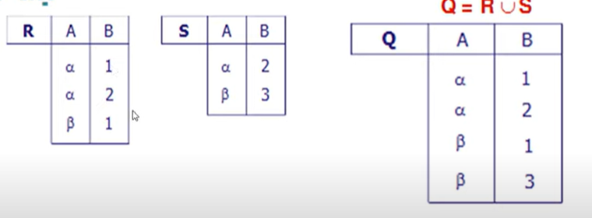
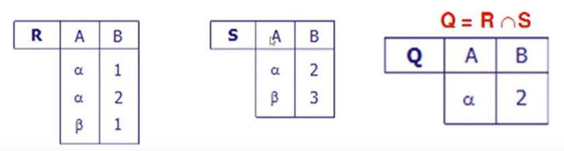
2.3 An Algebraic Query Language
Set operations
  Union
  Intersection

Slide 14
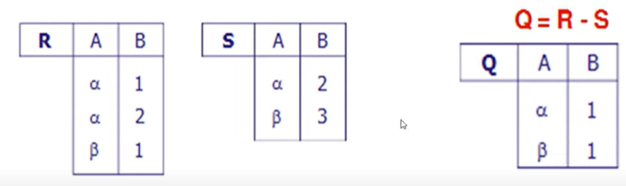
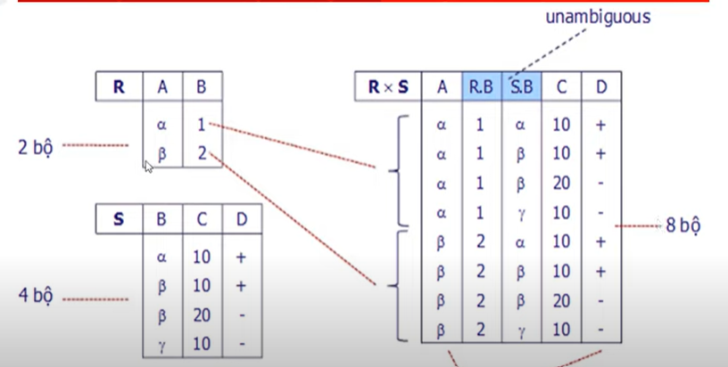

2.3 An Algebraic Query Language
Set operations
Except /Difference
  R \ S = { t | t ∈ R ∧ t ∉ S}
  Descartes

Slide 15
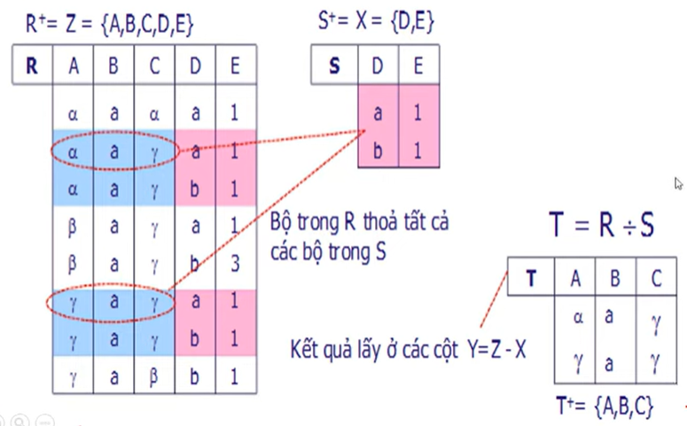
2.3 An Algebraic Query Language
Set operations
  Division

Slide 16
Set operations- Example
name | address | gender | birthdate
Carrie Fisher | 123 Maple St., Holywood | F | 9/9/99
Mark Hamill | 456 Oak Rd., Brentwood | M | 8/8/88
Relation R
name | address | gender | birthdate
Carrie Fisher | 123 Maple St., Holywood | F | 9/9/99
Harrison Ford | 789 Palm Dr., Beverly Hills | M | 8/8/88
Relation S

Slide 17
Set operations- Example
R ∪ S
name | address | gender | birthdate
Carrie Fisher | 123 Maple St., Holywood | F | 9/9/99
Mark Hamill | 456 Oak Rd., Brentwood | M | 8/8/88
Harrison Ford | 789 Palm Dr., Beverly Hills | M | 8/8/88
R ∩ S
name | address | gender | birthdate
Carrie Fisher | 123 Maple St., Holywood | F | 9/9/99
R \ S
name | address | gender | birthdate
Mark Hamill | 456 Oak Rd., Brentwood | M | 8/8/88

Slide 18
Selection and projection
Selection
- R1 := σ_{C} (R2) with C illustrated conditions
- ex: σ _{<C1>}(σ _{< C2>} ( R)) = σ _{<C2>} (σ _{< C1>} ( R)) = σ _{<C1> AND < C2>}
Movies
title | year | length | genre
Gone With the Wind | 1939 | 231 | Drama
Star Wars | 1977 | 124 | Scifi
Wayne’s World | 1992 | 95 | Comedy
σ_{length≥100}(Movies)
title | year | length | genre
Gone With the Wind | 1939 | 231 | Drama
Star Wars | 1977 | 124 | Scifi
Notes:
The Selection is commutative
The cascaded Selection may be applied in any order
Selection may be replaced by a single selection with a conjunction of all the conditions

Slide 19
Selection and projection
Projection S := π_{A1,A2,…,An} (R)
    A1,A2,…,An are attributes of R
    S relation schema S(A1,A2,…,An)
Movies
title | year | length | genre
Star Wars | 1977 | 124 | Scifi
Galaxy Quest | 1999 | 104 | Comedy
Wayne’s World | 1992 | 95 | Comedy
π_{title,year,length}(Movies)
π_{genre}(Movies)
title | year | length
Star Wars | 1977 | 124
Galaxy Quest | 1999 | 104
Wayne’s World | 1992 | 95
genre
Scifi
Comedy

Slide 20
Cartesian product and joins
Cartesian product R3 := R1 Χ R2
Relation R
Relation S
Cartesian Product R X S
A | B
1 | 2
3 | 4
B | C | D
2 | 5 | 6
4 | 7 | 8
9 | 10 | 11
A | R.B | S.B | C | D
1 | 2 | 2 | 5 | 6
1 | 2 | 4 | 7 | 8
1 | 2 | 9 | 10 | 11
3 | 4 | 2 | 5 | 6
3 | 4 | 4 | 7 | 8
3 | 4 | 9 | 10 | 11
Notes:
R3 := R1 Χ R2
Pair each tuple t1 of R1 with each tuple t2 of R2
Concatenation t1t2 is a tuple of R3
Schema of R3 is the attributes of R1 and then R2, in order
But beware attribute A of the same name in R1 and R2: use R1.A and R2.A
Suppose R1 has n1 attributes and tt1 tuples, R2 has n2 attributes and tt2 tuples,
then R3 has (n1+n2) attributes, and (tt1*tt2) tuples

Slide 21
Cartesian product and joins
  theta joins R3 := R1 ⋈_{<join condition>} R2
A | B | C
1 | 2 | 3
6 | 7 | 8
9 | 7 | 8
B | C | D
2 | 3 | 4
2 | 3 | 5
7 | 8 | 10
A | U.B | U.C | V.B | V.C | D
1 | 2 | 3 | 2 | 3 | 4
1 | 2 | 3 | 2 | 3 | 5
1 | 2 | 3 | 7 | 8 | 10
6 | 7 | 8 | 7 | 8 | 10
9 | 7 | 8 | 7 | 8 | 10
Relation U
Relation V
Figure 2.17: Result of U ⋈ _{A<D} V
A | U.B | U.C | V.B | V.C | D
1 | 2 | 3 | 7 | 8 | 10
Result of U ⋈ _{A<D AND U.B≠V.B} V
Notes:
R3 := R1 ⋈_{<join condition>} R2
Each tuple t1 of R1 connects with all those tuple t2 of R2 that satisfy <join condition>
<join condition> refers to attributes of R1 and R2
Schema of R3 is the attributes of R1 and then R2, in order
But beware attribute A of the same name in R1 and R2: use R1.A and R2.A
The result is constructed as follows
Take the product of R1 and R2
Select from the product only those tuples that satisfy the <join condition>
R1 ⋈_{<join condition>} R2 = σ _{<join condition>} (R1 x R2)

Slide 22
Cartesian product and joins
Natural join R3 := R1 ⋈ R2
Relation R
Relation S
Natural Join R ⋈ S
A | B
1 | 2
3 | 4
B | C | D
2 | 5 | 6
4 | 7 | 8
9 | 10 | 11
A | B | C | D
1 | 2 | 5 | 6
3 | 4 | 7 | 8
Notes:
R3 := R1 ⋈ R2
Pair only those tuples from R1 and R2 that agree in whatever attributes are common to the schema of R1 and R2
The result R3 keeps one component for each of the attributes in the union of the schemas of R1 and R2

Slide 23
Rename
The ρ operation gives a new schema to a relation
ρ_{S(A1,…,An)}(R) makes S be a relation with attributes A1,…,An and the same tuples as R
Simplified notation: S:=R (A1,A2,…,An)
R X ρ_{S(X,C,D)} (S)
Relation R
Relation S
A | B
1 | 2
3 | 4
B | C | D
2 | 5 | 6
4 | 7 | 8
9 | 10 | 11
A | B | X | C | D
1 | 2 | 2 | 5 | 6
1 | 2 | 4 | 7 | 8
1 | 2 | 9 | 10 | 11
3 | 4 | 2 | 5 | 6
3 | 4 | 4 | 7 | 8
3 | 4 | 9 | 10 | 11

Slide 24
Relational Expression
How we need relational expression
Relational algebra allows us to form expressions
Relational expression is constructed by applying operations to the result of other operations
Expressions can be presented as expression tree

Slide 25
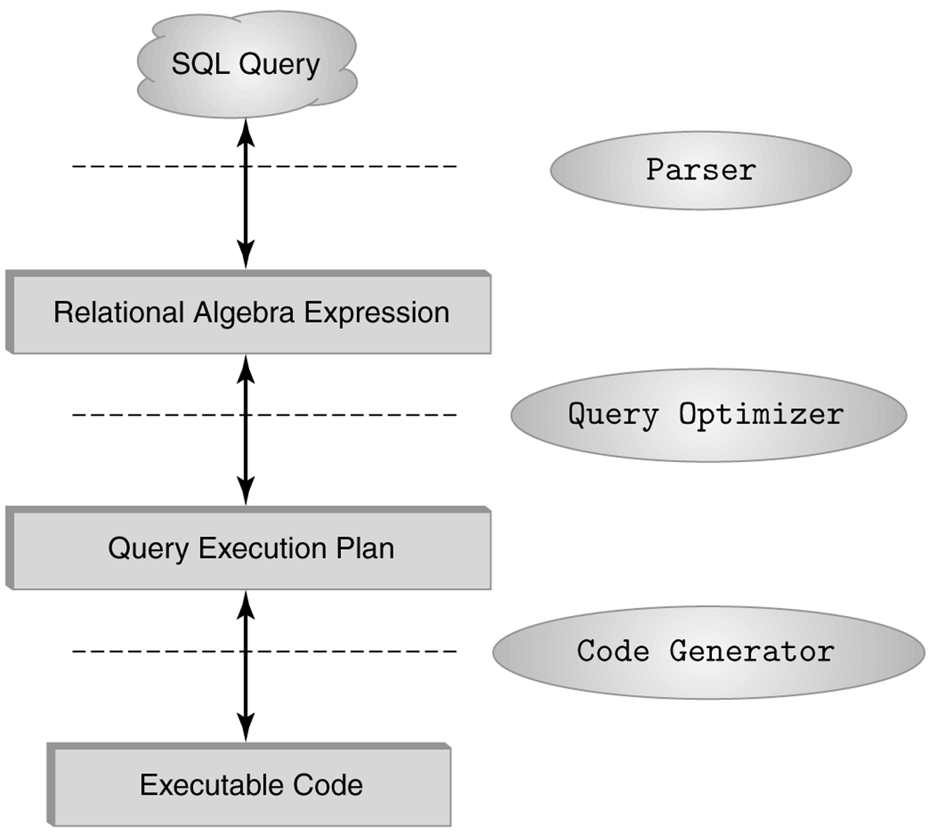
The role of relational algebra in a DBMS

Slide 26
Relational Expression
Example: What are the titles and years of movies made by Fox that are at least 100 minutes long?
  (1) Select those Movies tuples that have length ≥ 100
  (2) Select those Movies tuples that have studioName=‘Fox’
  (3) Compute the intersection of (1) and (2)
  (4) Project the relation from (3) onto attributes title and year

Slide 27
Relational Expression
π_{title,year}
∩
σ_{length>=100}
σ_{studioName=‘Fox’}
Movies
Movies
Figure 2.18: Expression tree for a relational algebra expression
π_{title,year}(σ_{length≥100} (Movies) ∩ σ_{studioName=‘Fox’} (Movies))
π_{title,year}(σlength≥100 AND studioName=‘Fox’ (Movies))

Slide 28

Relational Expression

Slide 29
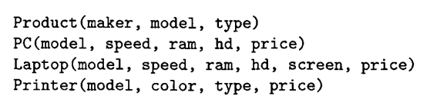
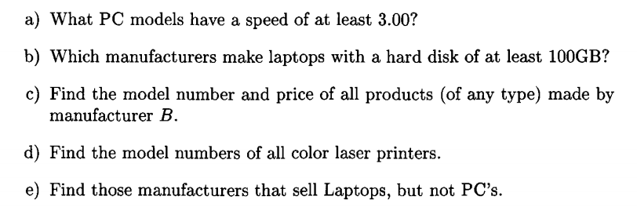
Exercise

Slide 30
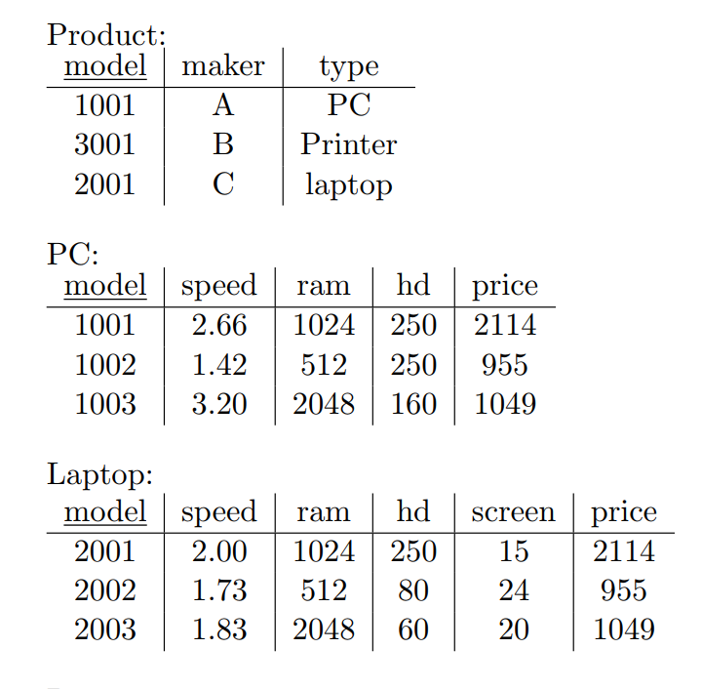
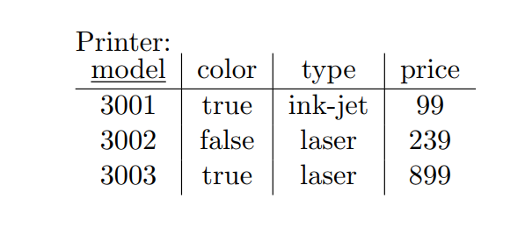
Exercise

